Slide 1
Welcome to Our Presentation YSW Department of Computer Science, Maharishi International University

Slide 2
Introduction
Agricultural development vs economic development
Farm education and extension program vs Agricultural development
Farm productivity (farm technical efficiency)
Competitiveness
Income and well-being

Slide 3
Introduction
Traditionally, the effectiveness of extension programs have been evaluated
Through change in farmers income or yield (Davis et al., 2012; Fortson et al., 2012; Wordofa and Sassi, 2014).
However, treatment effects using these measures
may not fully reflect the impact of extension programs in situations
where programs have lead to more efficient allocation of factors of production.
Undetected or miss-measured impact evaluation leads to sub-optimal fund allocation

Slide 4
Introduction
The measurement or potential gain from an extension program can be captured via technical efficiency measures
Rigorous methods of program evaluations help to attain more efficient fund allocation
Objective:
To develop a theoretical model that show technical efficiency and farm income can be equal or competitive evaluation methods
To demonstrates the comparison using randomized control trial (RCT) of a farmer training program in Armenia

Slide 5
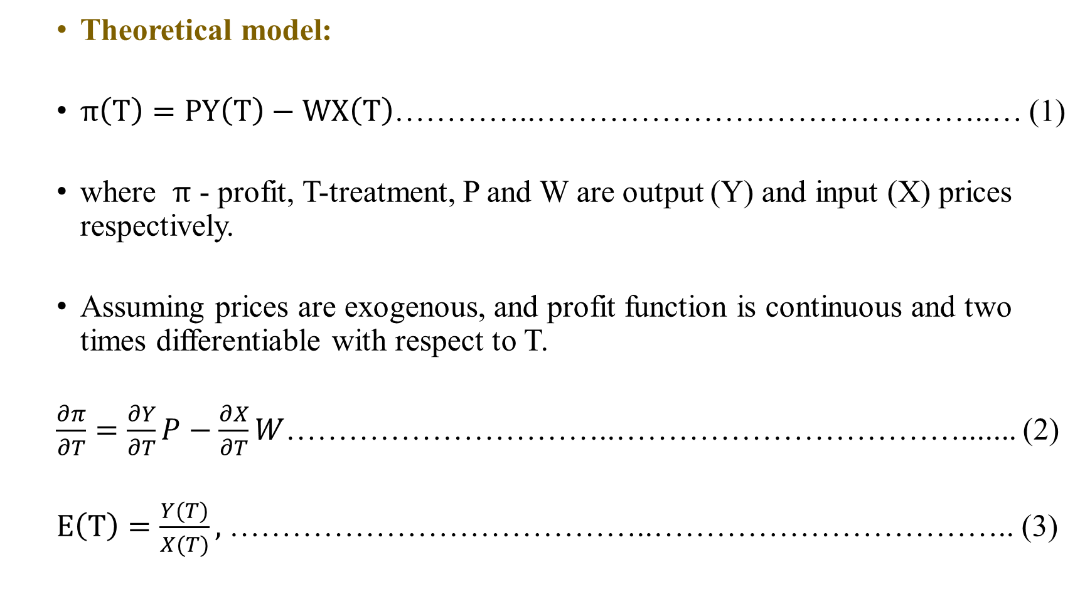
Methodology
Theoretical model:
$π\left(T\right)=PY\left(T\right)−WX\left(T\right)$…………..……………………………………..… (1)
where $π$ - profit, T-treatment, P and W are output (Y) and input (X) prices respectively.
Assuming prices are exogenous, and profit function is continuous and two times differentiable with respect to T.
$\frac{∂π}{∂T}=\frac{∂Y}{∂T}P−\frac{∂X}{∂T}W$…………………………..……………………………....... (2)
$E\left(T\right)=\frac{Y(T)}{X(T)},$ …………………………………..…………………………….. (3)

Slide 6

Methodology (cont...)
$\frac{∂E}{∂T}= \frac{\frac{∂Y}{∂T}X−\frac{∂X}{∂T}Y}{X^{2}}$……………….…..……………………………..…….…………. (4)
Rearrange terms:
$\frac{∂Y}{∂T}=\frac{∂E}{∂T}X+\frac{∂X}{∂T}E$ ………………...………………………………………....... (5)
Substituting equation (5) in to equation (2), gives:
$\frac{∂π}{∂T}=\frac{∂E}{∂T}PX+\frac{∂X}{∂T}(PE −W)$ ……………..……………………………………. (6)

Slide 7
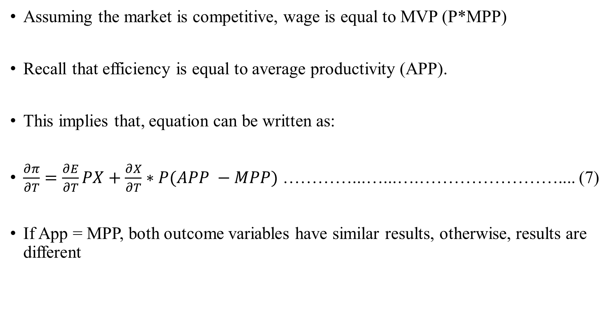
Methodology (cont...)
Assuming the market is competitive, wage is equal to MVP (P*MPP)
Recall that efficiency is equal to average productivity (APP).
This implies that, equation can be written as:
$\frac{∂π}{∂T}=\frac{∂E}{∂T}PX+\frac{∂X}{∂T}∗P(APP −MPP)$ …………...…...….…………………….... (7)
If App = MPP, both outcome variables have similar results, otherwise, results are different

Slide 8
Methodology (cont...)
Data:
Randomized Armenia panel survey data:
collected in 2007/2008 and 2010/2011 by
Millennium Challenge Corporation’s Compact (USIAD project).
Sample: 189 number of communities
112 were under treatment group and 77 were under control group
Sample size - 1515 (control: 40% and treatment: 60 %)

Slide 9
Methodology (cont...)
Table1: Summary Statistics: Mean value of variables
Variable | Definition | Mean | Std.
Age | Age of head of household in years | 57.10 | 12.58
Family size | Number of household size | 5.42 | 1.76
Gender | 1 if head of household female, 0 otherwise | 0.14 | 0.34
HVA | 1 if grow high value crops, 0 otherwise | 0.90 | 0.30
Nonfarm income | Amount of nonfarm income in dollars | 1354.66 | 1761.96
Secondary | 1 if completed high school and 0 otherwise | 0.40 | 0.49
Value of crops | Total value of crops per year in dollars | 1903.39 | 1737.21
Total farm cost | Amount of total farm cost per year in dollars | 663.30 | 585.30

Slide 10
Methodology (cont...)
Table1: Summary Statistics: Mean value of variables
Variable | Definition | Mean | Std.
Labor and equipment cost | Amount of labor and equipment cost per year in dollars | 334.17 | 299.07
Irrigation cost | Amount irrigation cost per year in dollars | 132.31 | 123.45
Other costs | Other costs per year in dollars | 385.92 | 367.73
Land | Land owned in acres | 1.83 | 1.78
Farm experience | Farm experience in years | 20.50 | 8.86
Livestock | 1 if farmer own it, 0 otherwise | 0.63 | 0.48
observations | 1515

Slide 11
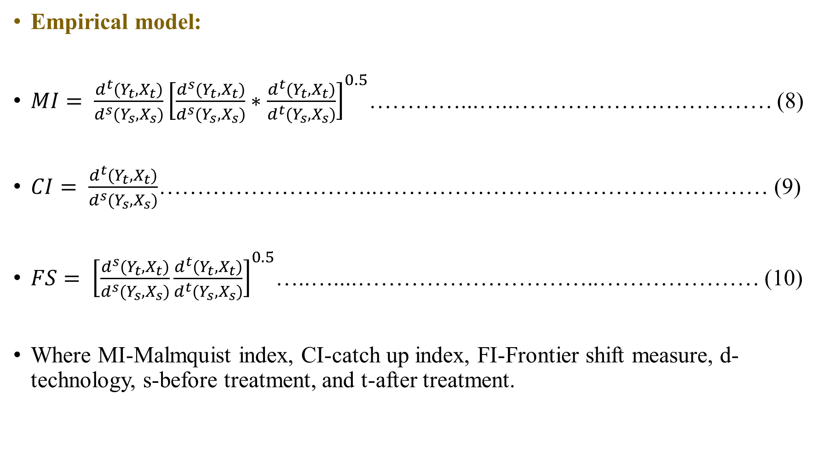
Methodology (cont...)
Empirical model:
$MI= \frac{d^{t}(Y_{t},X_{t})}{d^{s}(Y_{s},X_{s})}{\left[\frac{d^{s}(Y_{t},X_{t})}{d^{s}(Y_{s},X_{s})}∗\frac{d^{t}(Y_{t},X_{t})}{d^{t}(Y_{s},X_{s})}\right]}^{0.5}$…………...…..……………….…………… (8)
$CI= \frac{d^{t}(Y_{t},X_{t})}{d^{s}(Y_{s},X_{s})}$………………………..…………………………………………… (9)
$FS= {\left[\frac{d^{s}(Y_{t},X_{t})}{d^{s}(Y_{s},X_{s})}\frac{d^{t}(Y_{t},X_{t})}{d^{t}(Y_{s},X_{s})}\right]}^{0.5}$…..…....…………………………..………………… (10)
Where MI-Malmquist index, CI-catch up index, FI-Frontier shift measure, d-technology, s-before treatment, and t-after treatment.

Slide 12
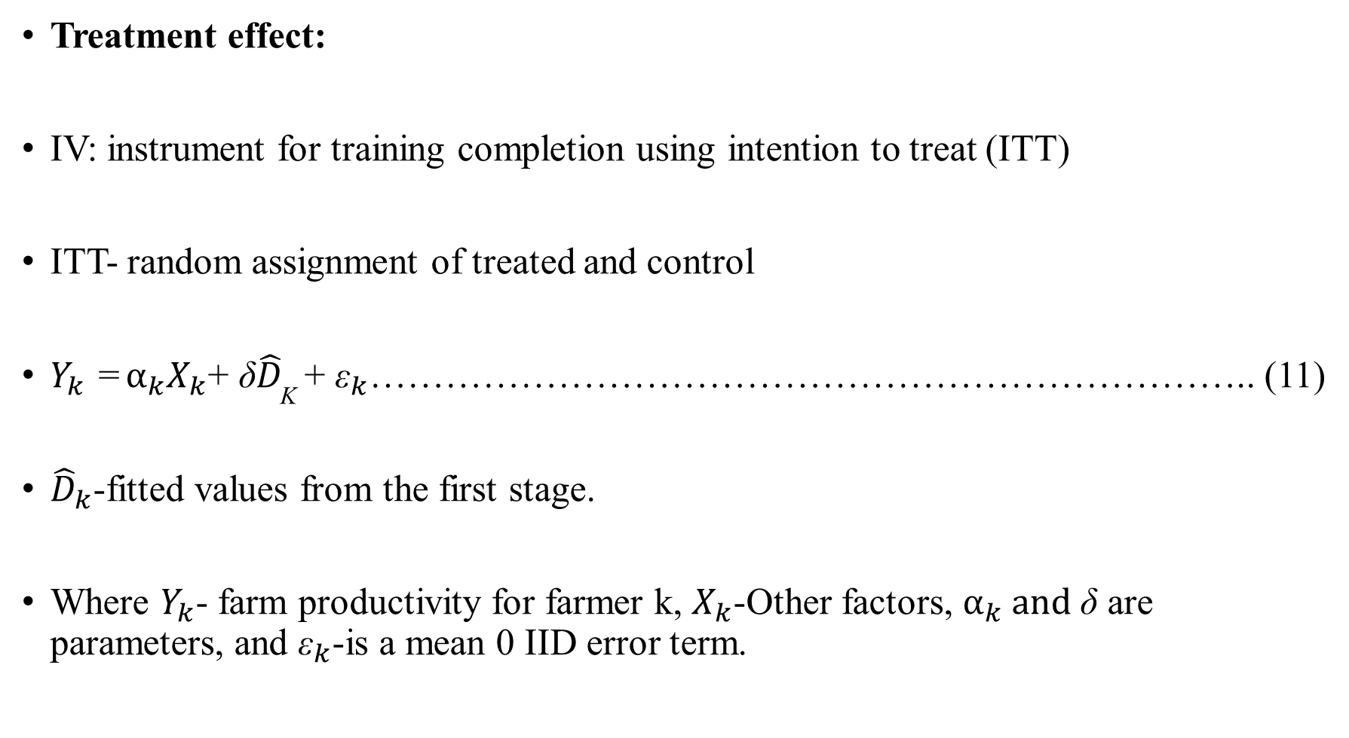
Methodology (cont...)
Treatment effect:
IV: instrument for training completion using intention to treat (ITT)
ITT- random assignment of treated and control
$Y_{k}$ = $α_{k}X_{k}$+ ${\text{δ}\hat{D}}_{\text{K}}$ + ${\text{ε}}_{k}$…………………………………………………………….. (11)
${\hat{D}}_{k}$-fitted values from the first stage.
Where $Y_{k}$- farm productivity for farmer k, $X_{k}$-Other factors, $α_{k} and \text{δ}$ are parameters, and ${\text{ε}}_{k}$-is a mean 0 IID error term.

Slide 13
Result and Discussion
Median of farm productivity
Type of farmers | Farm productivity | without cluster | within cluster
Commercial farmers | Catch-up | 1.00 | 0.92
 | Frontier shift | 0.87 | 1.21
 | Malmquist Index | 0.89 | 1.15
Semi-commercial | Catch-up | 1.06 | 1.02
 | Frontier shift | 0.90 | 1.09
 | Malmquist Index | 0.95 | 1.13
Subsistent farmers | Catch-up | 1.21 | 0.93
 | Frontier shift | 0.75 | 1.00
 | Malmquist Index | 0.89 | 0 .87

Slide 14
Result and Discussion
Treatment effect
Value in parentheses are standard errors
Type of farmers | Farm productivity | without cluster | within cluster
Commercial farmers | Catch-up | -0.310 (0.28) | -0.249 (0.543)
 | Frontier shift | 0.408 (0.31) | 0.492** (2.440)
 | Malmquist Index | 0.100 (0.41) | 0.300 (1.00)
Semi-commercial | Catch-up | 0.066 (0.14) | 1.246 (1.560)
 | Frontier shift | 0.022 (0.10) | 0.262 (0.73)
 | Malmquist Index | 0.082 (0.10) | 0.606 (1.56)
Subsistent farmers | Catch-up | -0.145 (0.26) | 0.052 (1.470)
 | Frontier shift | -0.138 (0.26) | 0.018 (0.20)
 | Malmquist Index | -0.113 (0.18) | 0.083 (0.54)

Slide 15
Result and Discussion
Median of farm productivity
Are different among with and without clustering
Generally, treatment effect is
Not significantly different from zero in both with and without clustering
Our result is similar to the result found by Fortson et al. (2012), which they examined the treatment effect on income change.

Slide 16
Conclusion and Recommendation
Treatment effect is statistically insignificant across all
Type of farm productivity and farmers
Evaluating using change in farm productivity and income showed similar results.
This does not mean our proposition, effect of extension program on farm productivity or farm income could be differ is invalid
We have a condition where the two show the same result.
This shows that the methods are robust

Slide 17
References
Davis, K., Nkonya, E., Kato, E., Mekonnen, D. A., Odendo, M., Miiro, R., & Nkuba, J. (2012). Impact of farmer field schools on agricultural productivity and poverty in East Africa. World Development, 40(2), 402-413.
Fortson, K., Rangarajan, A., Blair, R., Lee, J., & Gilbert, V. (2012).Evaluation of water-to-market training in Armenia (No. 8336f2393a7f4513b95947ee7face8b0). Mathematica Policy Research.
Wordofa, M. G., & Sassi, M. (2014). Improving Smallholder Farmers’ Income through Farmer Training Centers: an Impact Evaluation in Haramaya District, Ethiopia.

Slide 18


Thank you!

Slide 19



